Slide 1
Python Programming Language Foundation
Session 12
Notes:
1

Slide 2
Session overview
Definition of thread & process
Threads in Python
Synchronization primitives
GIL
Multiprocessing
Python Programming Solutions ©
2
Notes:
2

Slide 3
Definition of thread & process
Python Programming Solutions ©
3

Slide 4
Process
A process is an instance of a computer program that is being sequentially executed by a computer system that has the ability to run several computer programs concurrently.
https://simple.wikipedia.org/wiki/Process_(computing)
Python Programming Solutions ©
4
Notes:
4

Slide 5
Thread
Threads are a way for a program to divide (termed "split") itself into two or more simultaneously (or pseudo-simultaneously) running tasks.
https://simple.wikipedia.org/wiki/Thread_(computer_science)​
Python Programming Solutions ©
5
Notes:
5

Slide 6
How it works
Two threads can run concurrently on the same processor core by interleaving executable instructions. For example, thread 1 runs for 10ms, thread 2 runs for 10ms etc.
https://softwareengineering.stackexchange.com
Python Programming Solutions ©
6
Notes:
6

Slide 7
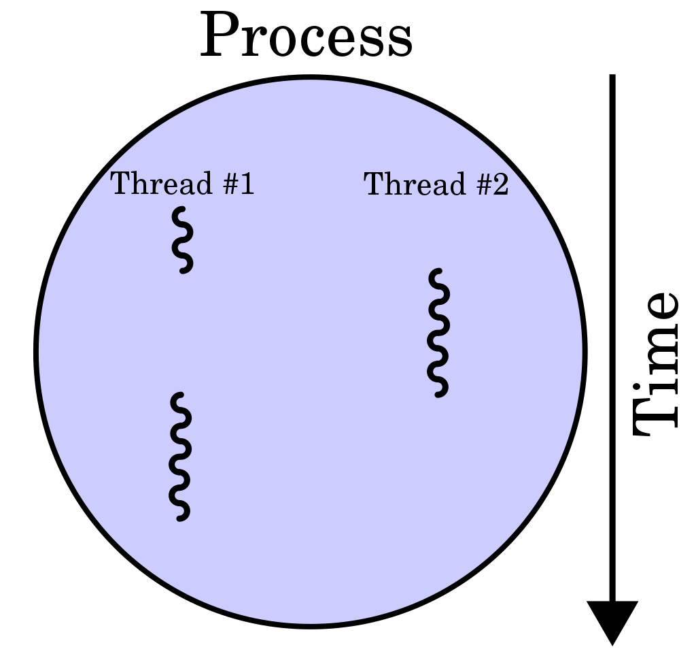
How it works
https://simple.wikipedia.org/wiki/Thread_(computer_science)
Python Programming Solutions ©
7
Notes:
7

Slide 8
Process VS Thread
A Process is mostly isolated, whereas Threads share memory.
https://www.guru99.com/difference-between-process-and-thread.html
Python Programming Solutions ©
8
Notes:
8

Slide 9
Process VS Thread
Multi-Threading
Multi-Processing
Application/Program/Process
Application/Program/Process
Memory
Memory
Memory
Memory
Thread 1
Thread 1
Thread 1
Sub-process 1
Sub-process 2
Sub-process 3
https://morioh.com/p/bfc237e21e77
Python Programming Solutions ©
9
Notes:
9

Slide 10
Threads in Python
Python Programming Solutions ©
10

Slide 11
How to create thread instance
import threading
def foo(arg1, arg2, kwarg):
#TODO: Create something very important
pass
thread = threading.Thread(
target=foo,
args=(arg1, arg2),
kwargs={kwarg_name: kwarg_value}
)
Python Programming Solutions ©
11
Notes:
11

Slide 12
Methods
start()
run()
join()
Python Programming Solutions ©
12
Notes:
12

Slide 13
Daemon
While a regular (non-daemon) thread blocks the main program to exit if they are not dead. A daemon thread runs without blocking the main program from exiting. And when main program exits, associated daemon threads are killed too.
Python Programming Solutions ©
13

Slide 14
Synchronization Primitives
Python Programming Solutions ©
14

Slide 15
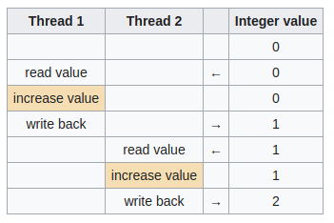
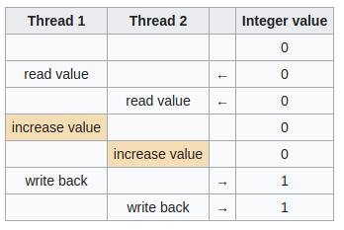
Race condition
https://en.wikipedia.org/wiki/Race_condition
Python Programming Solutions ©
15
Notes:
15

Slide 16
Synchronization Primitives
threading.
Lock
RLock
Event
Semaphore
Condition
Barrier
https://betterprogramming.pub/synchronization-primitives-in-python-564f89fee732
Python Programming Solutions ©
16
Notes:
16

Slide 17
Lock
threading.
Lock
RLock
Event
Semaphore
Condition
Barrier
https://betterprogramming.pub/synchronization-primitives-in-python-564f89fee732
Python Programming Solutions ©
17
Notes:
17

Slide 18
Lock methods
acquire()
release()
Python Programming Solutions ©
18
Notes:
18

Slide 19
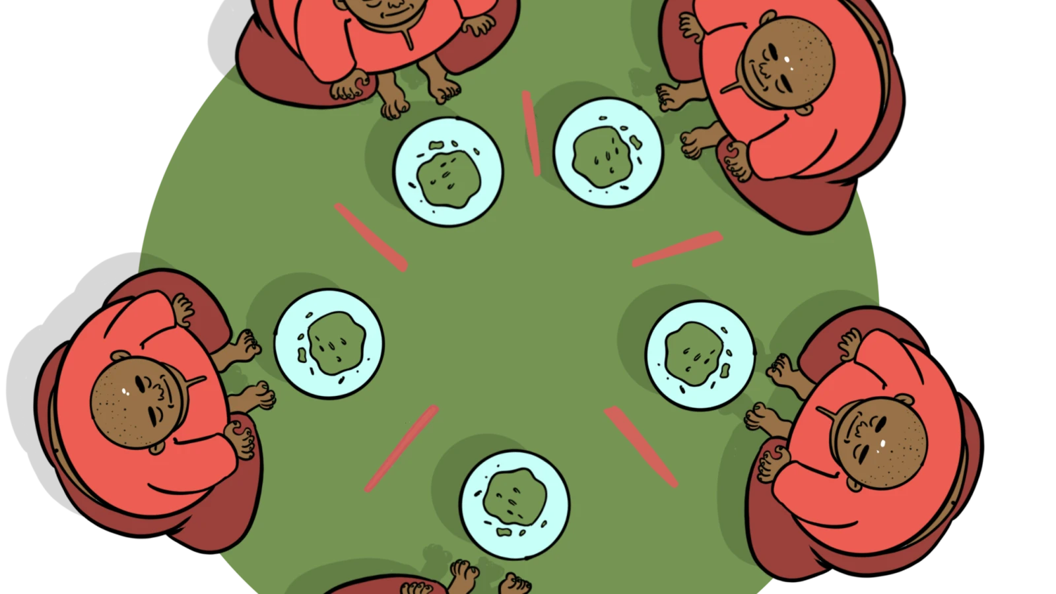
Deadlock (Dining philosophers' problem)
https://en.wikipedia.org/wiki/Deadlock​
Python Programming Solutions ©
19
Notes:
19

Slide 20
GIL
Python Programming Solutions ©
20

Slide 21
GIL
The mechanism used to assure that only one thread executes Python bytecode at a time.
https://docs.python.org/3/glossary.html#term-global-interpreter-lock
Python Programming Solutions ©
21
Notes:
21

Slide 22
Unwritten Rules of Python
You do not talk about the GIL.
https://www.dabeaz.com/python/UnderstandingGIL.pdf
Python Programming Solutions ©
22
Notes:
22

Slide 23
Unwritten Rules of Python
You do NOT talk about the GIL.
https://www.dabeaz.com/python/UnderstandingGIL.pdf
Python Programming Solutions ©
23
Notes:
23

Slide 24
Unwritten Rules of Python
Don't even mention the GIL. No seriously.
https://www.dabeaz.com/python/UnderstandingGIL.pdf
Python Programming Solutions ©
24
Notes:
24

Slide 25
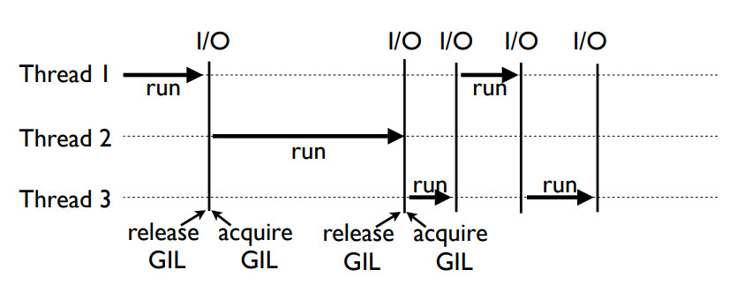
How it works
https://www.youtube.com/watch?v=AWX4JnAnjBE
Python Programming Solutions ©
25
Notes:
25

Slide 26
Multiprocessing
Python Programming Solutions ©
26

Slide 27
How to create process instance
import multiprocessing
def foo(arg1, arg2, kwarg):
#TODO: Create something very important
pass
process = multiprocessing.Process(
target=foo,
args=(arg1, arg2),
kwargs={kwarg_name: kwarg_value}
)
Python Programming Solutions ©
27

Slide 28
Methods
start()
run()
join()
terminate() / kill()
Python Programming Solutions ©
28
Notes:
28

Slide 29
Pool
Pool is a multiprocessing class that allows to parallelize the execution of a function across the multiple input values.
Python Programming Solutions ©
29
Notes:
29

Slide 30
Dummy
Multiprocessing.dummy is just a full replication of the multiprocessing API but is also a wrapper around threading module.
Python Programming Solutions ©
30

Slide 31

Thanks for attention
Questions?
Python Programming Solutions ©
31
Notes:
31

